Slide 1

Bakery Sales Overview
This project focuses on analyzing sales data from a bakery using Power BI. The dashboard helps visualize item-wise performance, customer behavior, and time-based trends to support better business decisions.

Slide 2

Analyze bakery transaction data Understand sales patterns by item, time, and customer behavior Provide interactive visuals for business decisions

Slide 3


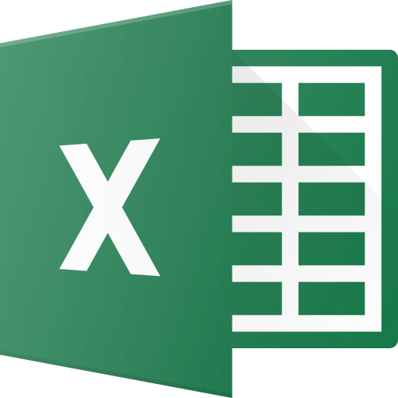

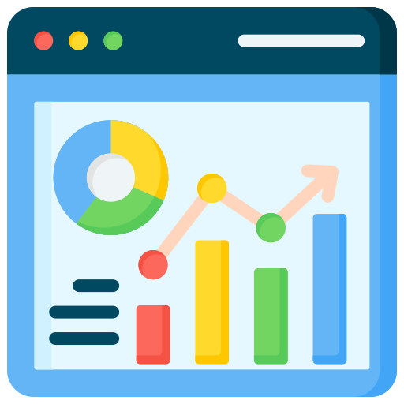
Tools and Technologies Used
Power bi
Excel
DAX
Data Visualization
Power BI is a data visualization tool used to create interactive dash boards. It was used in this project to analyze and display bakery sales data.
Excel was used to clean and prepare the bakery sales data before importing into Power BI.Basic functions and filters helped remove duplicates and correct errors.It ensured the data was accurate and ready for analysis.
DAX (Data Analysis Expressions) is a formula language used in Power BI.It was used to create calculated columns and measures in this project.DAX helped perform custom calculations like totals and averages.
Data visualization techniques help turn raw data into visual insights.Charts like bar graphs, line charts, and matrix tables were used in this project.These visuals made it easy to understand sales trends and customer behavior.

Slide 4
Power bi
Excel
DAX
Data Visualization
Power BI is a data visualization tool used to create interactive dash boards. It was used in this project to analyze and display bakery sales data.
Excel was used to clean and prepare the bakery sales data before importing into Power BI.Basic functions and filters helped remove duplicates and correct errors.It ensured the data was accurate and ready for analysis.
DAX (Data Analysis Expressions) is a formula language used in Power BI.It was used to create calculated columns and measures in this project.DAX helped perform custom calculations like totals and averages.
Data visualization techniques help turn raw data into visual insights.Charts like bar graphs, line charts, and matrix tables were used in this project.These visuals made it easy to understand sales trends and customer behavior.

Slide 5
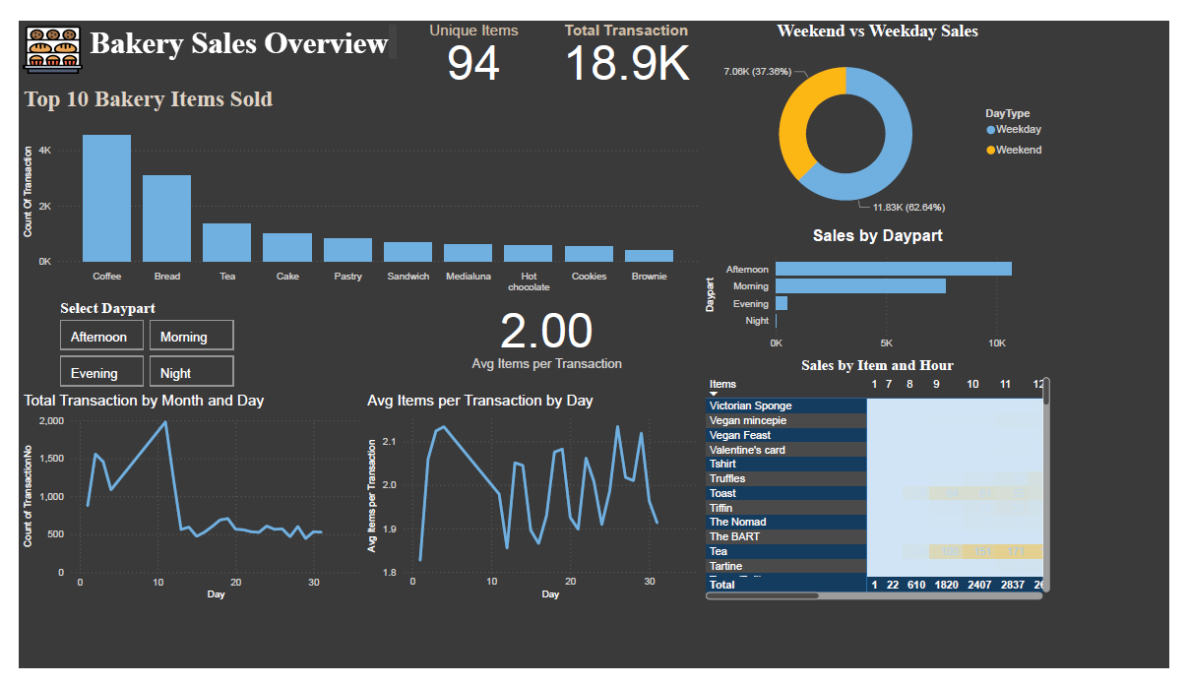
Bakery Sales Dashboard Overview

Slide 6
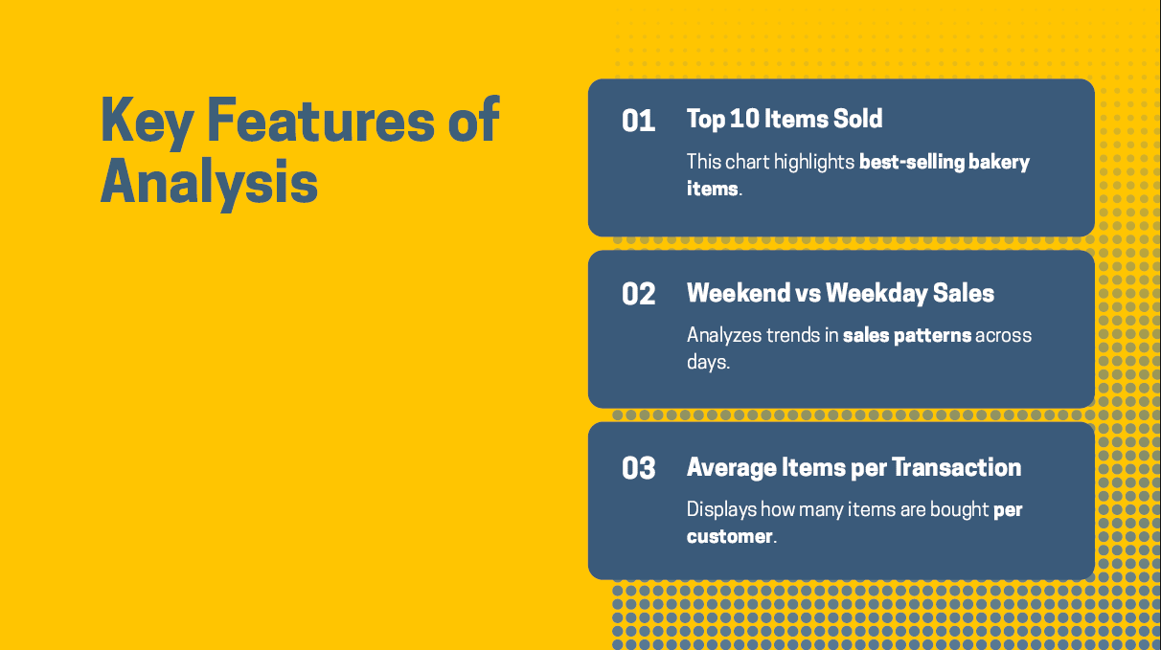

Slide 7
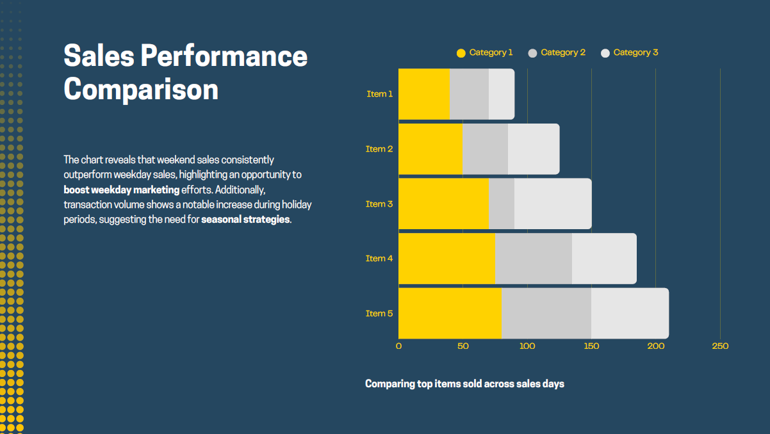

Slide 8
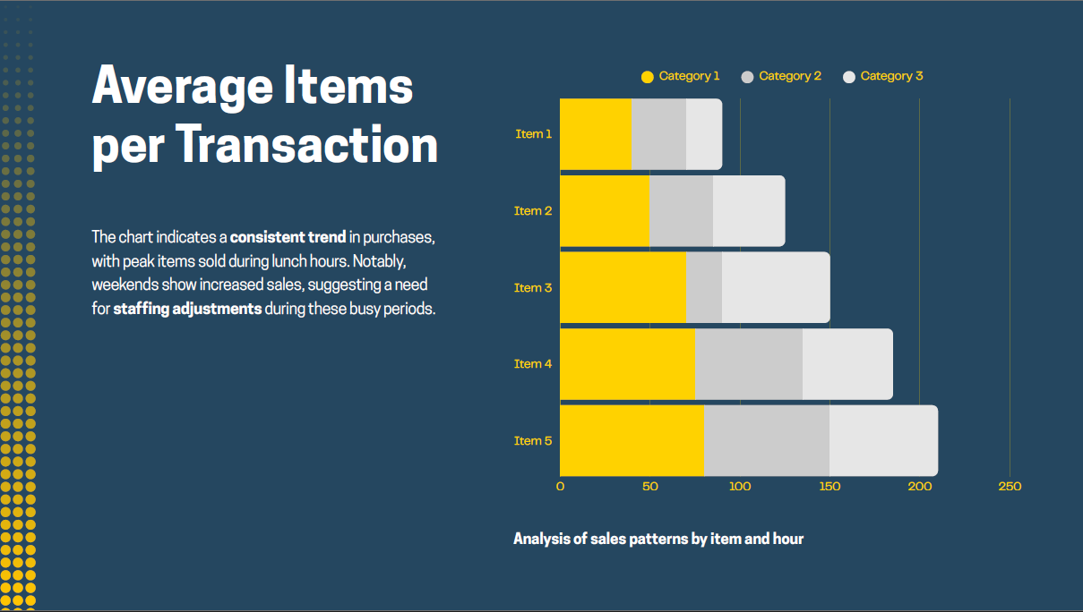

Slide 9
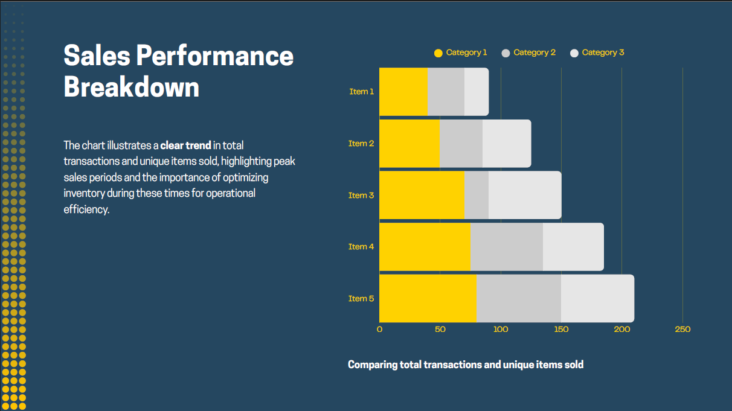

Slide 10
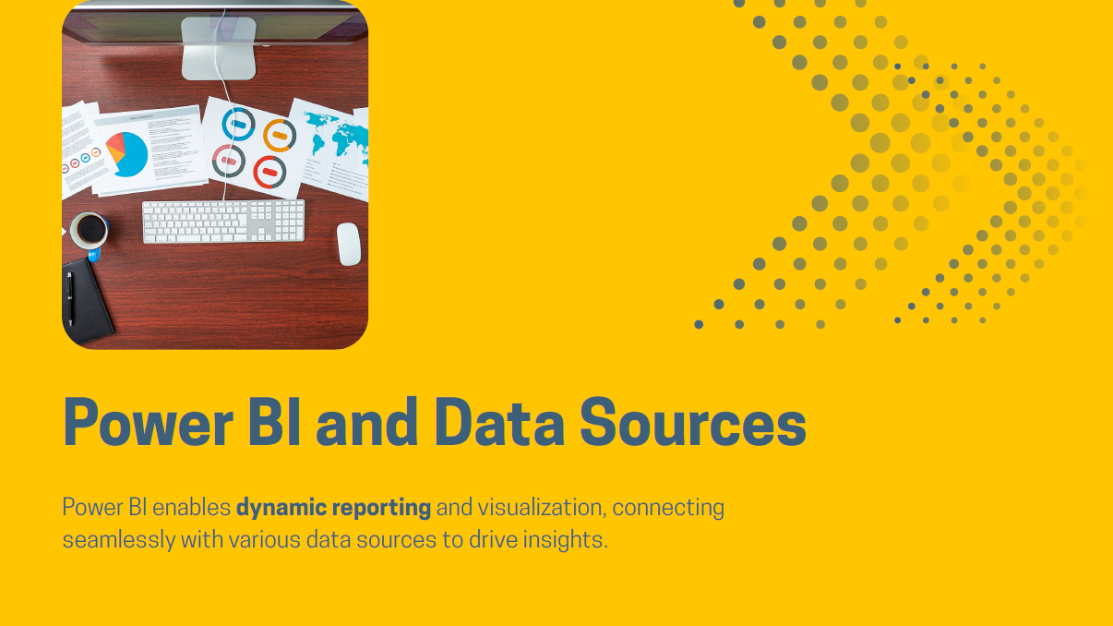

Slide 11
